Slide 1

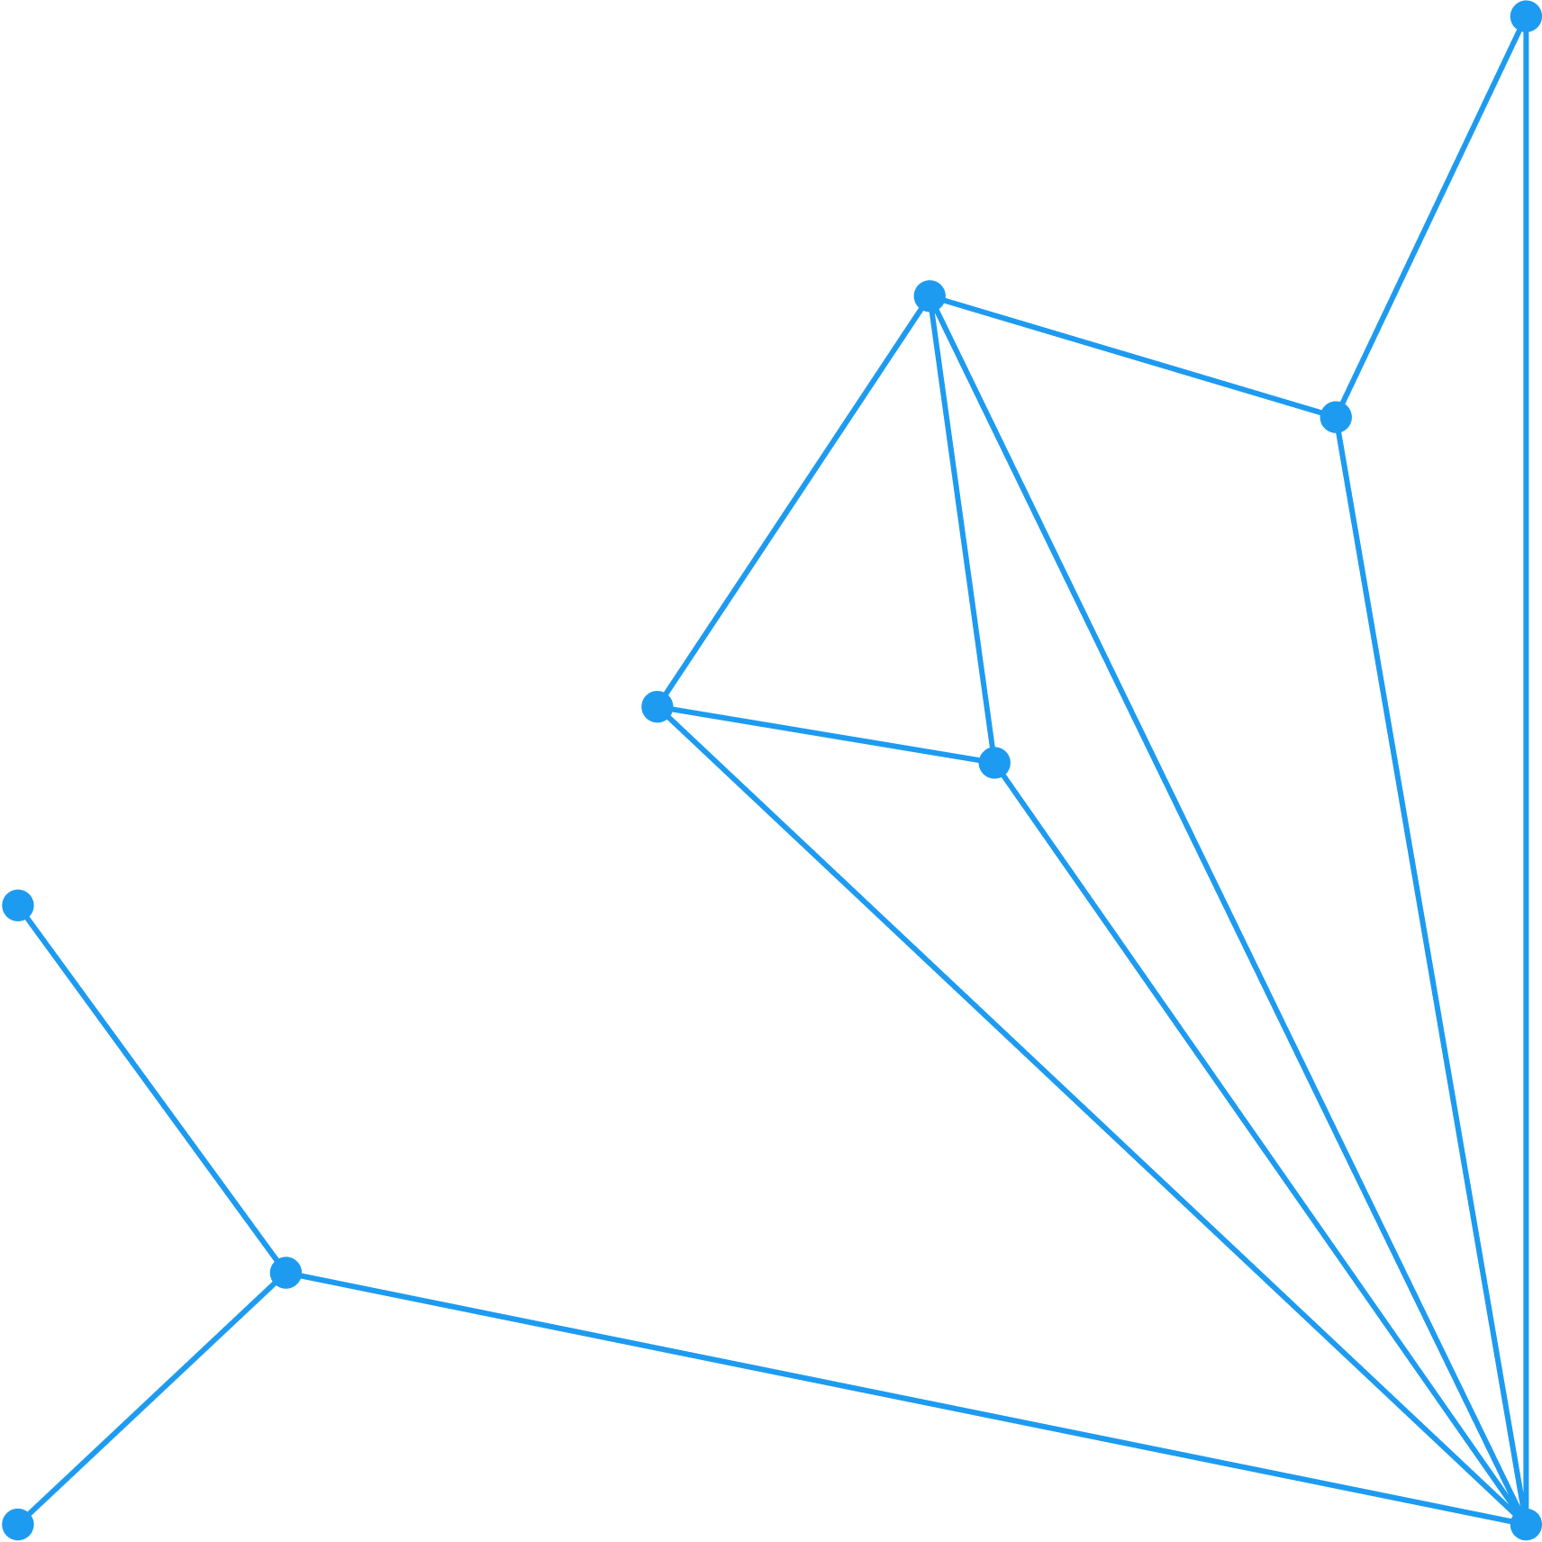





Adding Seasonality
Elementary Vector-Host Model
BY [Dr. Stephanie Kamunya, Postdoctoral Fellow, CEMA]
1

Slide 2
Seasonality of Malaria
Malaria transmission typically peaks during specific times of the year (e.g., rainy seasons) and declines during others, creating a wave-like pattern.
The cosine function is ideal for modeling such regular, repeating fluctuations over time.
3

Slide 3
The Cosine Function
In our model:
β_{t} = β₀(1+ β₁*cos(2π(t - φ)))
3

Slide 4
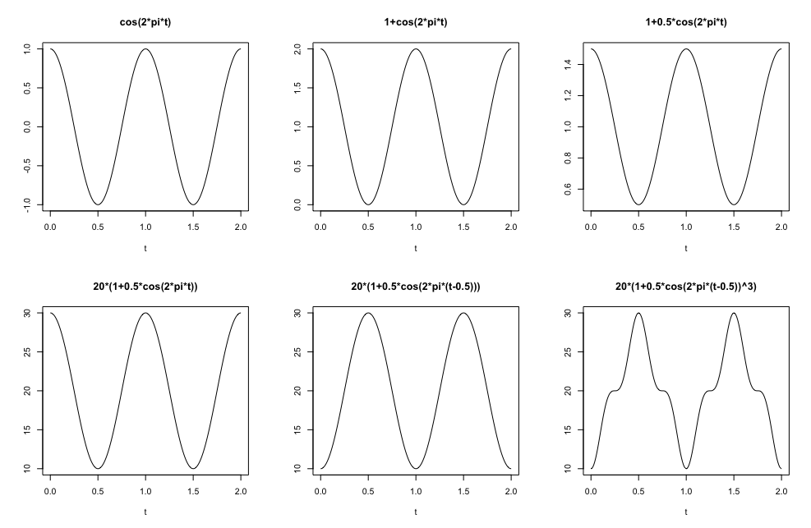
The Cosine Function (Examples)
3

Slide 5
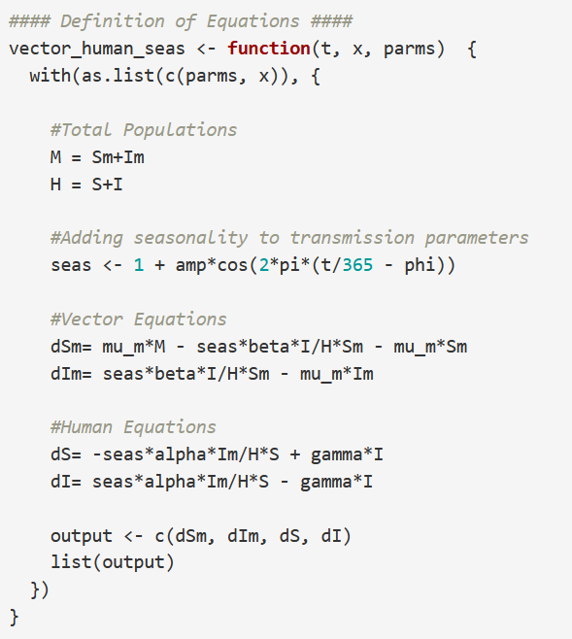
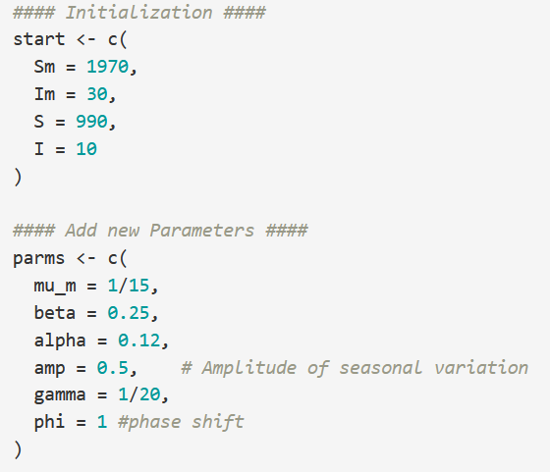
The Cosine Function
In the R code
3

Slide 6
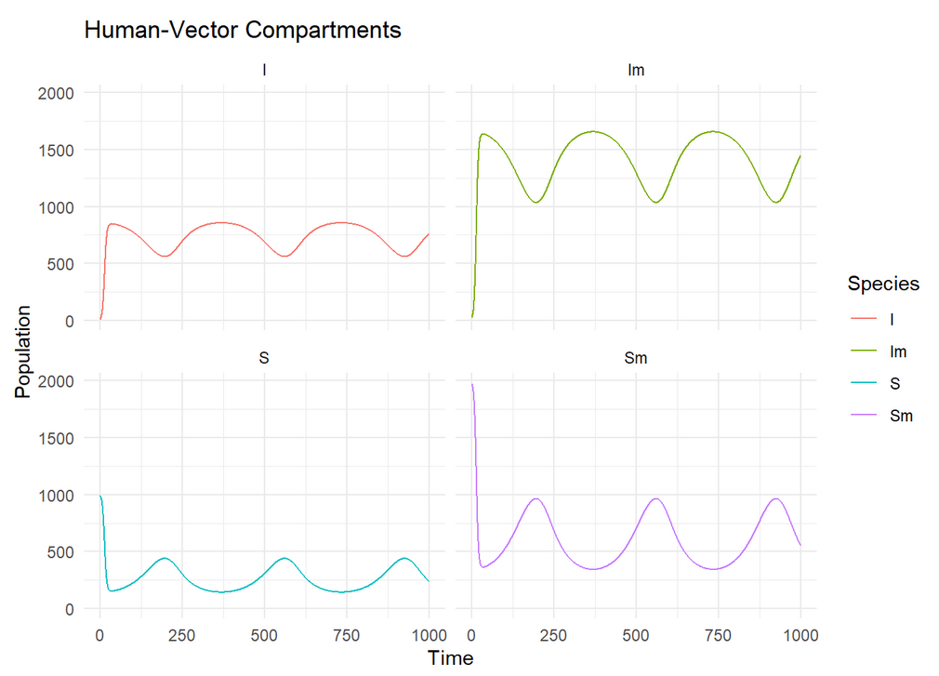
Plot Results
3

